Slide 1
RespTable:
Lightweight Responsive Tables
Information Architecture and Web Usability
Group 3
28 Jan 2025
Alexander Kassil, Daniel Hevesy-Szettyan, Dominik Bauer, and Miloš Globočki
Copyright 2025 by the author(s), except as otherwise noted.
This work is placed under a Creative Commons Attribution 4.0 International (CC BY 4.0) licence
1 / 13

Slide 2
Responsive Table Libraries
Display tables across different screen sizes.
Enhance user experience by using responsive patterns.
Using libraries saves time in development.
Libraries have well-tested designs and layouts.
Consistent usability across the application.
2 / 13

Slide 3
Comparing Responsive Table Libraries
Larger Libraries:
Big Package size.
A lot of features.
Extensive Documentation.
Complex feature activation.
TanStack Table, AG Grid, Handsontable.
Compact Libraries:
Lack of features.
Small documentation.
Hard to extend.
Grid.js, Tablesaw, JSTable.
3 / 13

Slide 4
Our Project Vision
A lightweight, responsive table library for HTML that ensures tables look great on all devices.
Designed to integrate seamlessly with other libraries or frameworks (e.g. React, Vue, etc.).
Open-source for collaboration, contribution, and adoption.
Available for everyone to use.
4 / 13

Slide 5
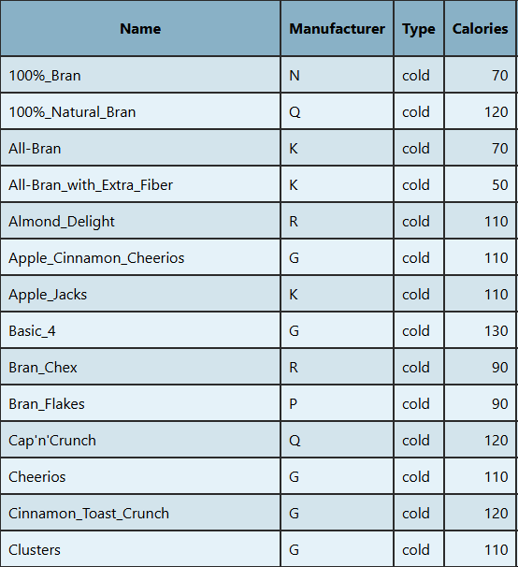
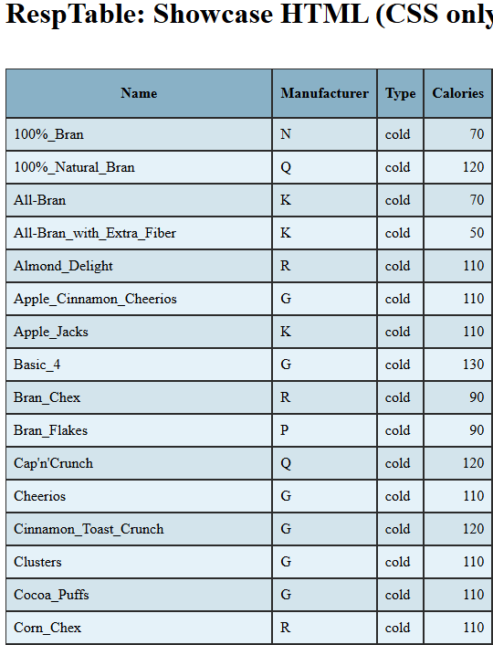
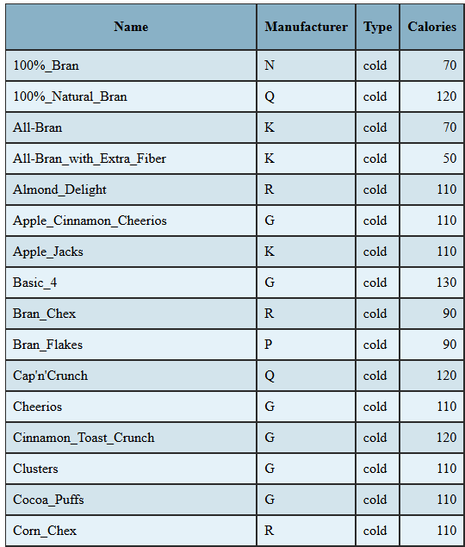
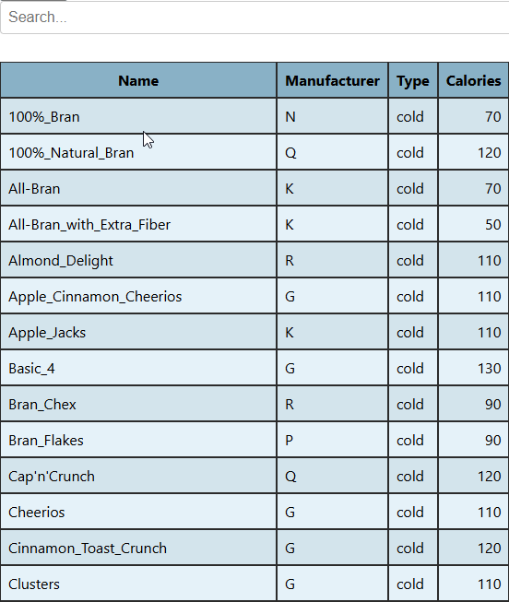
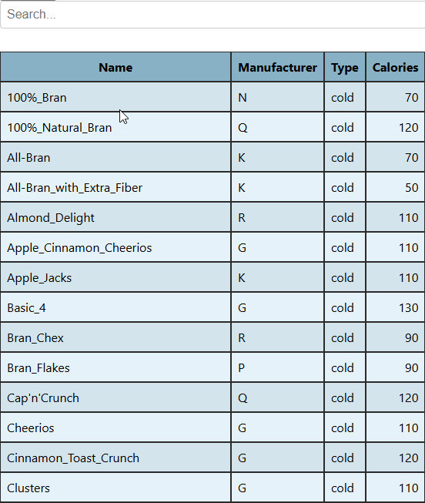
Pattern Showcase
Stacking
Filtering
Sorting
5 / 13

Slide 6
Goals
Responsiveness: Tables should adapt to different sizes of screens.
Framework Agnostic: Work with any CSS library or JavaScript framework.
Lightweight: Small file size, minimal configuration.
Extensible: Allow developers to add custom styles or behaviors.
Accessible: Supports various accessibility features out of the box.
6 / 13

Slide 7
Table Patterns
Responsive Patterns:
Stacking ✓
Squishing ✓
Flipping ✓
Horizontal Scrolling ✓
Good Practice Patterns:
Sorting ✓
Filtering ✓
Fixed Header ✓
Zebra Stripes ✓
Easy Column Alignment ✓
7 / 13

Slide 8
Responsive Table Patterns for Tables
Stacking: Convert rows into vertical stacks.
Squishing: Fitting the table into smaller spaces by reducing its size.
Flipping: Transposing the table by turning columns into rows and vice versa.
Horizontal Scrolling: Adding a horizontal scrollbar to the table.
8 / 13
Notes:
Our library will empower developers to build better tables with minimal effort.
A small, modular tool can solve a universal problem.
Let’s aim for simplicity, usability, and extensibility.
Start simple – focus on one or two responsive strategies (e.g., stacking or scrollable).
Prioritize developer experience – easy to install, configure, and use.
Build a small demo project for showcasing real-world applications.
Encourage contributions from the open-source community.

Slide 9
Good Practice Patterns for Tables
Sorting: Rearrange rows by clicking on the column header to sort the values in ascending/descending order.
Filtering: Display only rows that match a filter criteria.
Fixed Header: Keep the header row visible while scrolling through the table.
Zebra Stripes: Alternating background color to enhance row visibility.
Easy Column Alignment: Keep text left and numbers right.
9 / 13
Notes:
Our library will empower developers to build better tables with minimal effort.
A small, modular tool can solve a universal problem.
Let’s aim for simplicity, usability, and extensibility.
Start simple – focus on one or two responsive strategies (e.g., stacking or scrollable).
Prioritize developer experience – easy to install, configure, and use.
Build a small demo project for showcasing real-world applications.
Encourage contributions from the open-source community.

Slide 10
Additional Features
Good practice patterns enabled by default.
Simple activation of different patterns for tables.
Loading data with csv files.
Three examples:
HTML and CSS only.
HTML and JS with CSV loading.
React implementation.
10 / 13
Notes:
Our library will empower developers to build better tables with minimal effort.
A small, modular tool can solve a universal problem.
Let’s aim for simplicity, usability, and extensibility.
Start simple – focus on one or two responsive strategies (e.g., stacking or scrollable).
Prioritize developer experience – easy to install, configure, and use.
Build a small demo project for showcasing real-world applications.
Encourage contributions from the open-source community.

Slide 11
Library Structure
RespTable
|-- dist/ Contains the built library files.
| |-- cjs/
| `-- esm/
|-- examples/ Includes three example projects demonstrating how to use the library.
| |-- html/
| |-- html-with-csv/
| |-- react/
| `-- README.md
|-- node_modules/ Contains all the dependencies installed via npm.
|-- src/ Contains the library's source code.
| |-- components/ All the JS code.
| |-- styles/ All the CSS code.
| |-- index.js
| `-- README.md
|-- gulpfile.js
|-- LICENCE
|-- package.json
|-- rollup.config.js
`-- README.md
11 / 13

Slide 12
Integration Example
Import the library with desired modules:
Create a table and apply a pattern by calling functions:
import { LoadCSV, CreateTable, ApplyStacking } from './respTable.js';
const csvData = await LoadCSV('./cereals.csv');
CreateTable(csvData);
ApplyStacking();
12 / 13

Slide 13
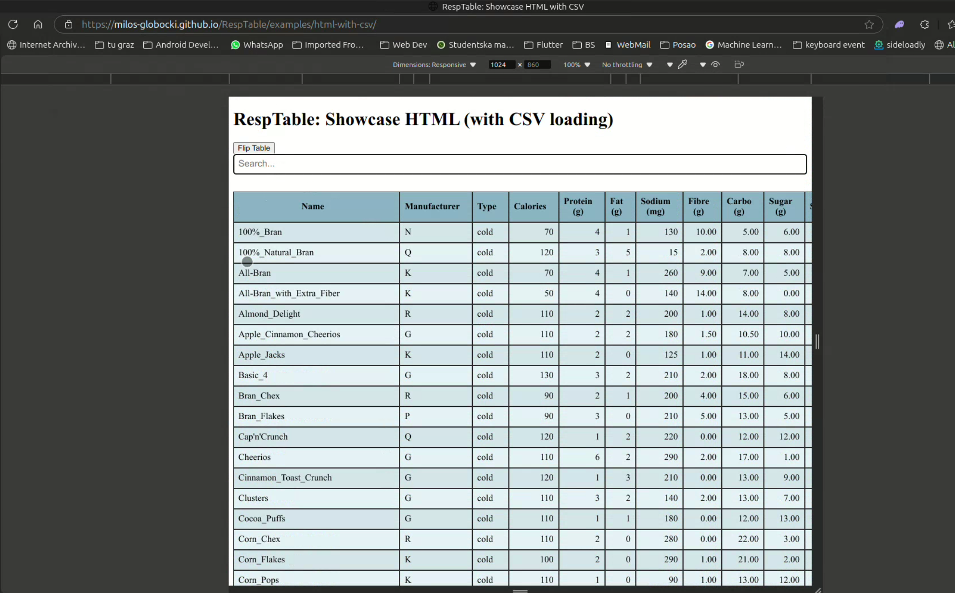
Showcase
Showcase video on YT: https://youtu.be/3FPELCNy-5k
Github Repo: https://github.com/milos-globocki/RespTable
Live Demo on Github Pages: https://milos-globocki.github.io/RespTable/examples/html-with-csv/ https://milos-globocki.github.io/RespTable/examples/html/
13 / 13

