Slide 1
Modern CSS
Survey Presentation
Information Architecture and Web Usability
Winter Term 2025/26
Group 1 - Christian Burtscher, Jonas Glaser, Marcus Gugacs, Eva Haring
02 Dec 2025

Slide 2

Outline
What is Modern CSS
Features of Modern CSS:
Layouts
Properties
Pseudo-class
@-Rules
Functions
Other
NoNewNews Demo
Future Work

Slide 3
What is Modern CSS
Preprocessors like Sass emerged over 19 years ago.
Aim to add features missing in CSS.
Frequent updates to CSS over past decade resulted in what we now know as Modern CSS. ¹
Modern CSS added most features of preprocessors:
Including variables, nesting, functions, conditionals.
Important but missing for now are only mixins.
Baseline identifies web platform features supported across popular browsers. ²
1 https://beyond-the-cascade.com/do-we-still-need-css-preprocessors-in-2024/
2 https://developer.mozilla.org/en-US/docs/Glossary/Baseline

Slide 4
Features of Modern CSS

Slide 5
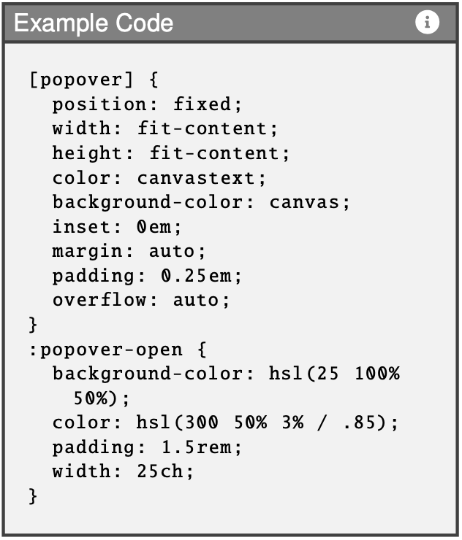
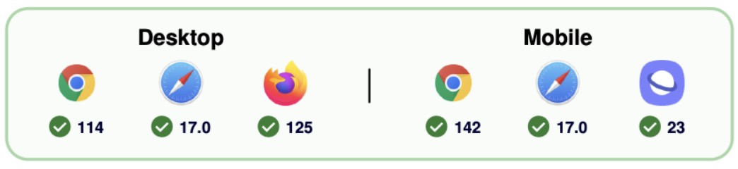
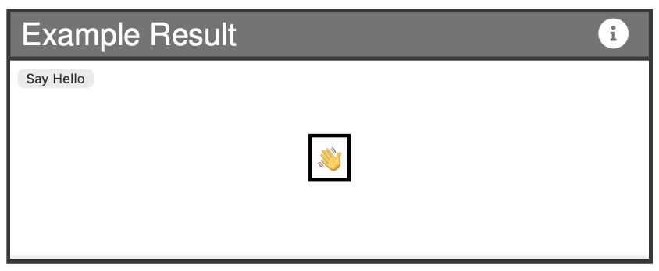
Layouts: popover-open
Baseline 2024
Controlled by HTML or JS.
Draw user's attention to specific information.
Combination with CSS pseudo-class to change appearance of popover element.
1
2
1 https://caniuse.com/?search=popover-open
2 https://css-tricks.com/almanac/pseudo-selectors/p/popover-open/

Slide 6
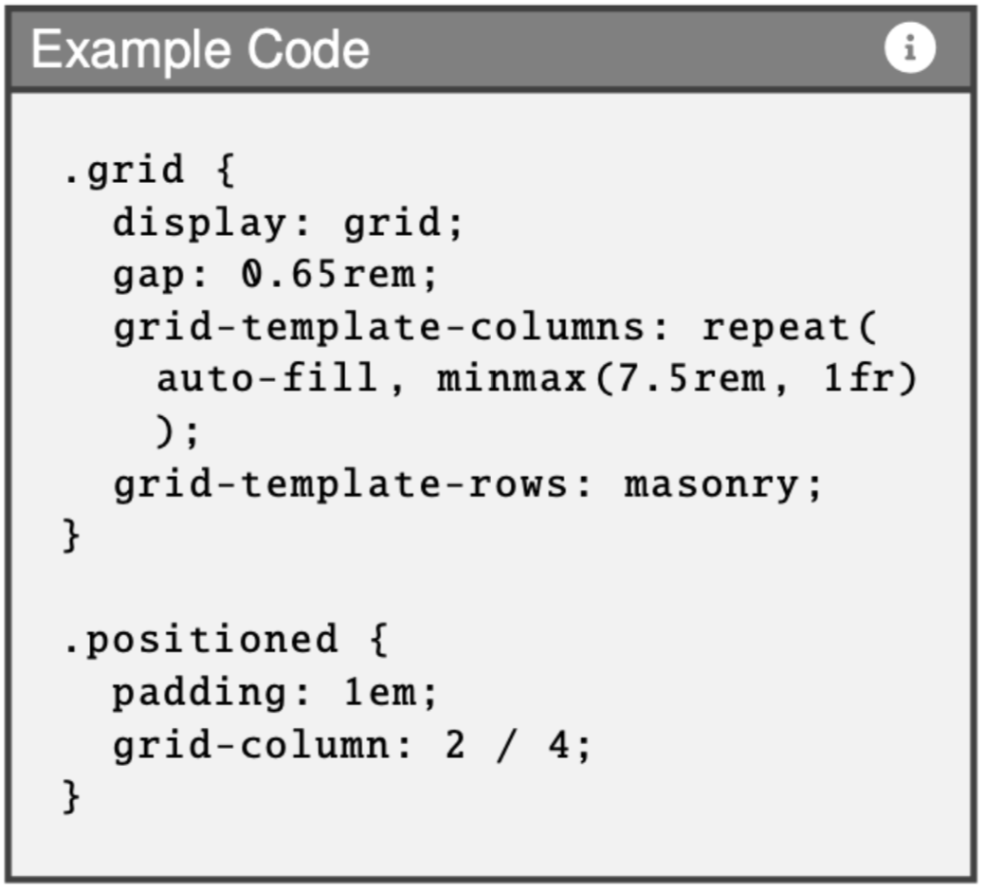
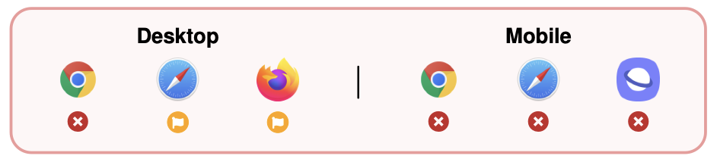
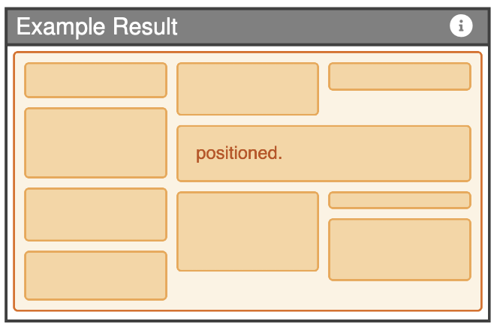
Layouts: Masonry Layouts
Experimental
Dynamic layout method without JS.
Automatic fill up of grid gaps.
One strict axis and one masonry axis.
1
2
1 https://caniuse.com/?search=masonry
2 https://developer.mozilla.org/en-US/docs/Web/CSS/Guides/Grid_layout/Masonry_layout

Slide 7
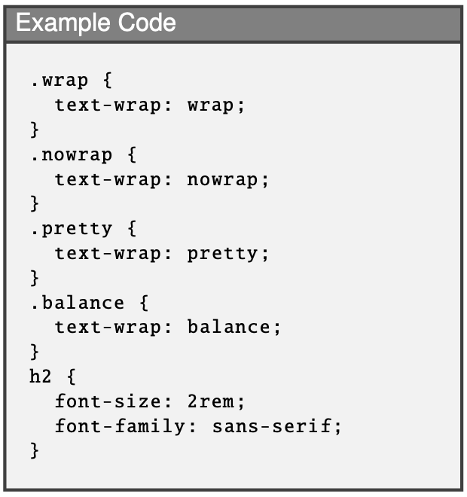

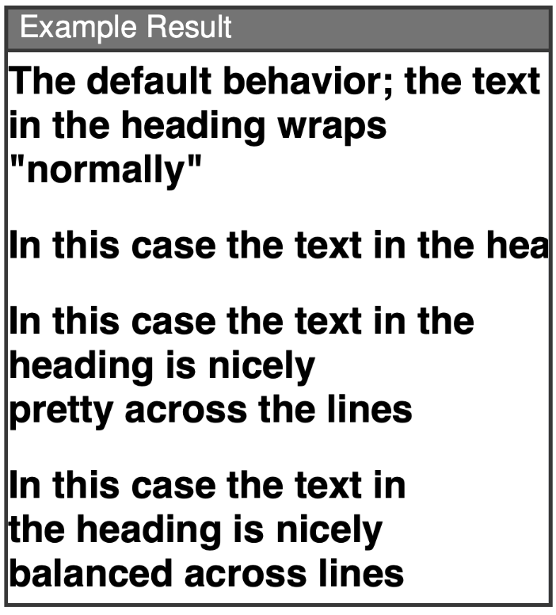
Properties: text-wrap
Baseline 2024
Offers multiple wrapping modes: wrap, pretty, stable, balance, nowrap.
Simplifies inclusion of typographical content.
Improves readability.
1
2
1 https://caniuse.com/?search=text-wrap
2 https://developer.mozilla.org/en-US/docs/Web/CSS/Reference/Properties/text-wrap

Slide 8
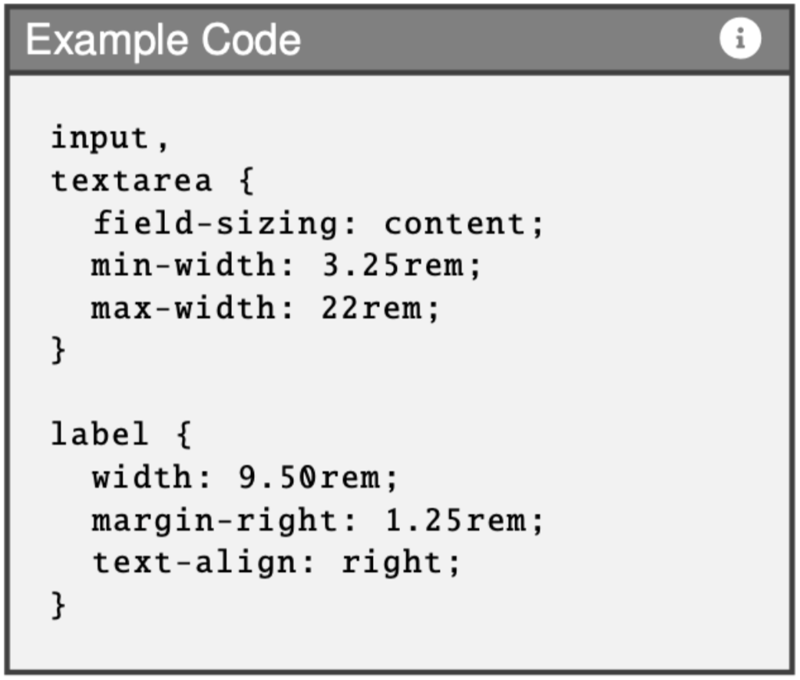
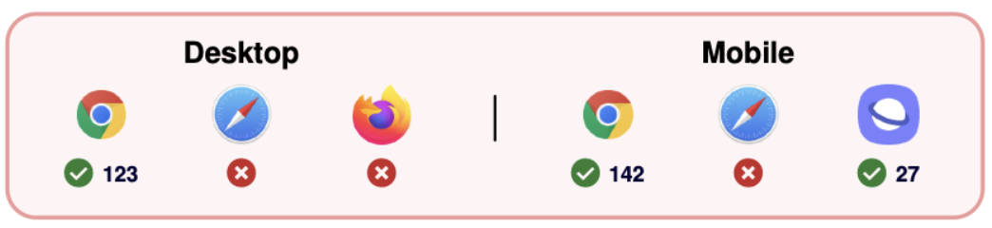
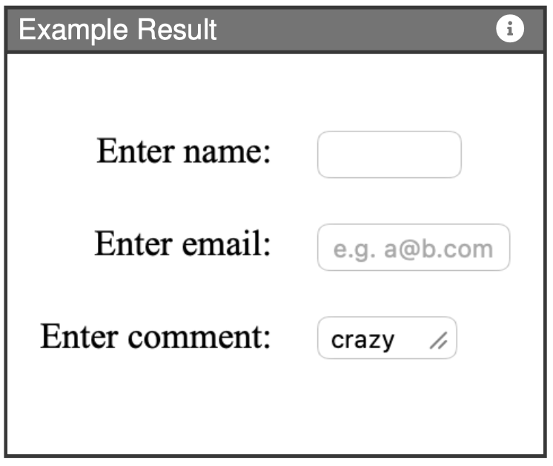
Properties: field-sizing
Experimental
Automatically resize form controls.
Size is based on their content.
Grow or shrink respectively.
1
2
1 https://caniuse.com/?search=field-sizing
2 https://developer.mozilla.org/en-US/docs/Web/CSS/Reference/Properties/field-sizing

Slide 9
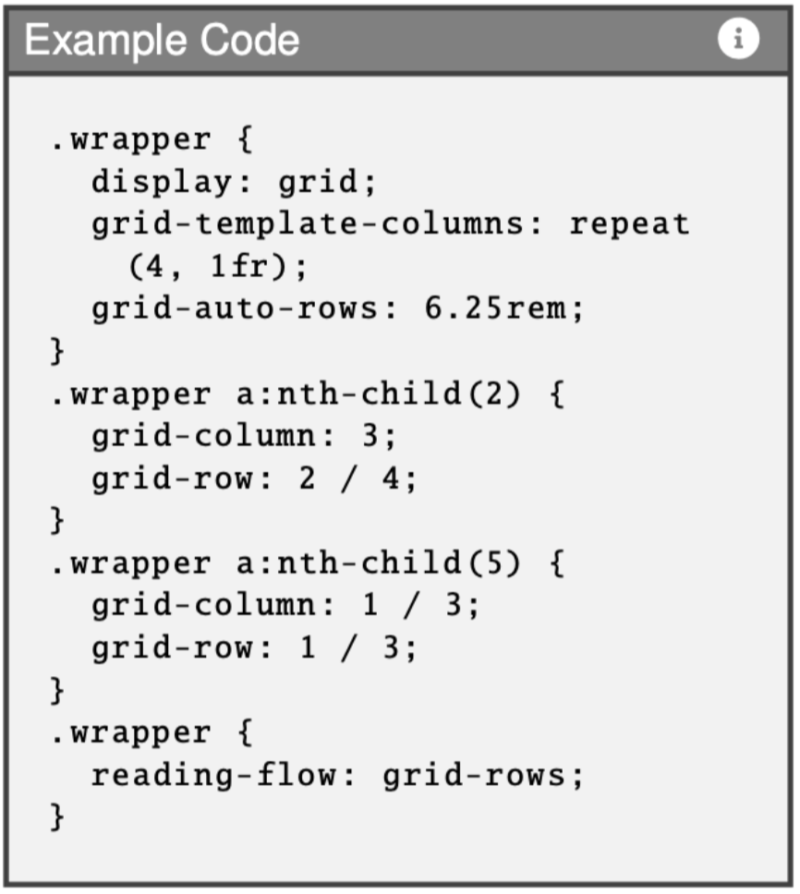
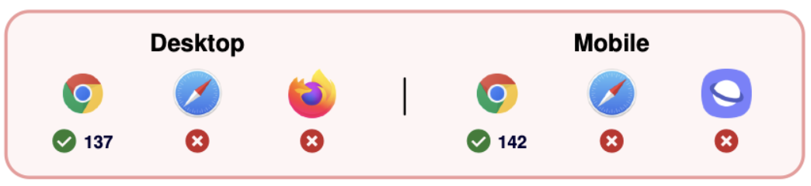
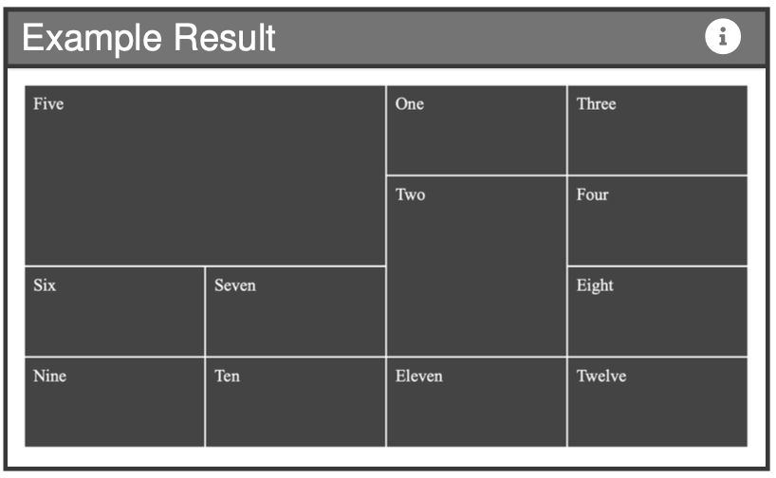
Properties: reading-flow
Experimental
Accessibility feature.
Control logical order of elements within layout.
Specify navigation of assistive technologies when visual order differs from DOM order.
1
2
1 https://caniuse.com/?search=reading-flow
2 https://developer.chrome.com/blog/reading-flow

Slide 10
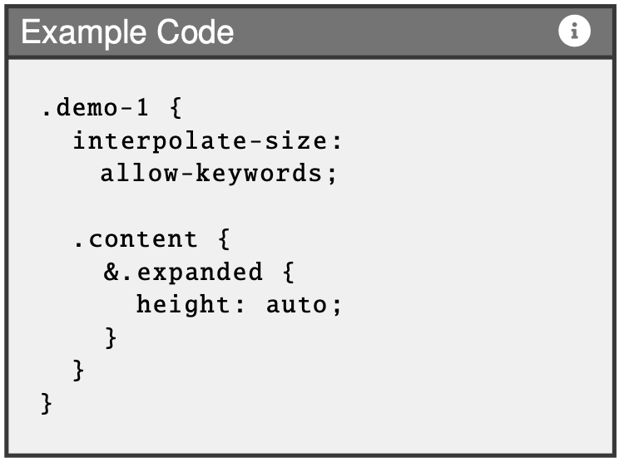
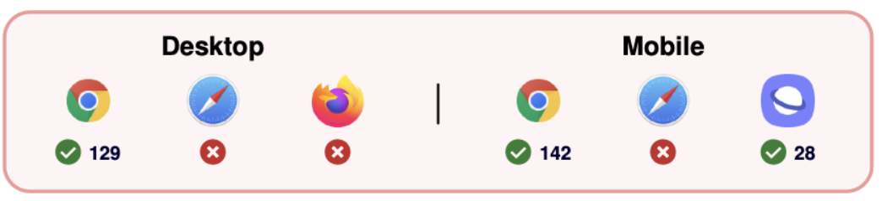
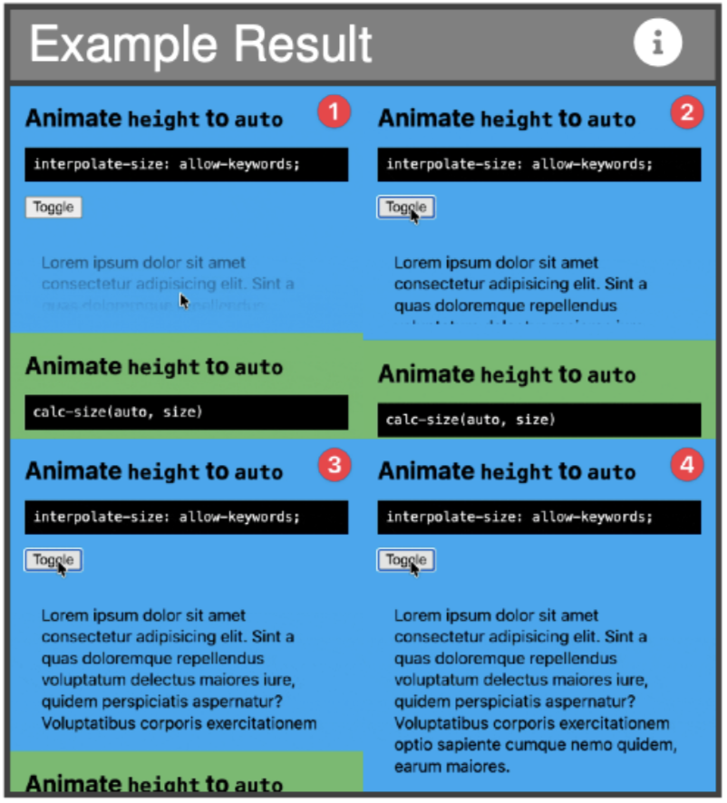
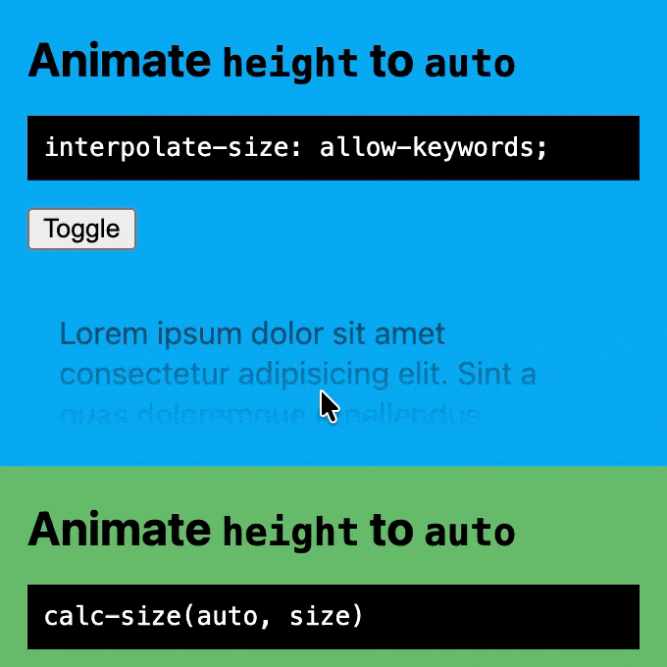
Properties: interpolate-size
Experimental
Same as function calc-size(auto, …).
Known as “Animate to Auto”.
Animate elements between fixed size values and intrinsic sizes.
1
2
1 https://caniuse.com/?search=interpolate-size%3A+allow-keywords
2 https://frontendmasters.com/blog/what-you-need-to-know-about-modern-css-2025-edition/

Slide 11
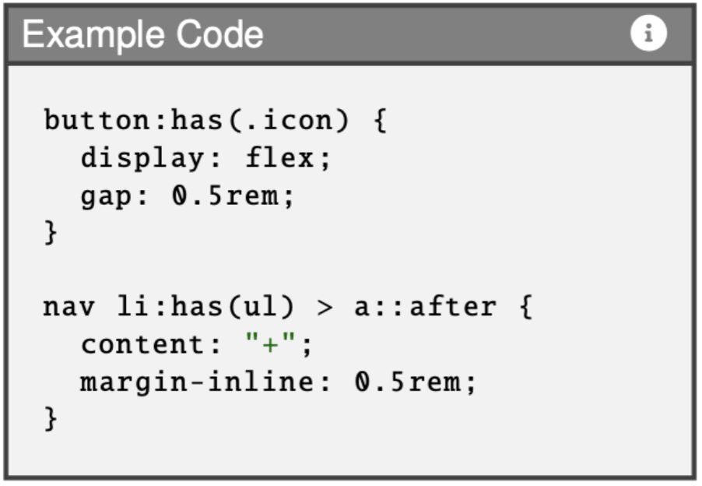
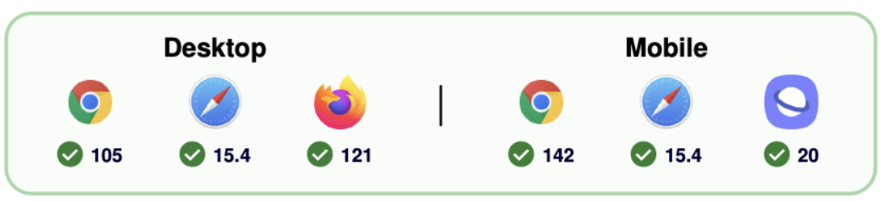
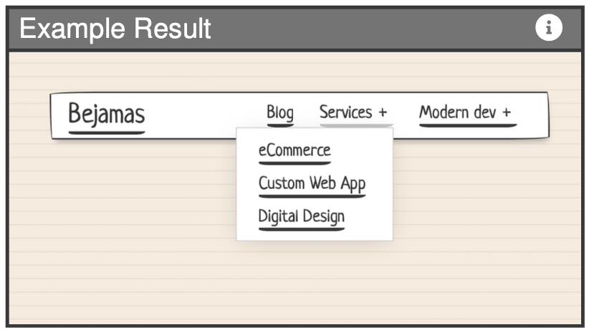
Pseudo-class: has()
Baseline 2023
Select elements based on descendant elements.
Apply styling rules to parent or ancestor element.
Is able to select upwards in the DOM tree.
1
2
1 https://caniuse.com/?search=has%28%29
2 https://bejamas.com/hub/guides/learn-css-has-selector-by-examples-top-use-cases

Slide 12
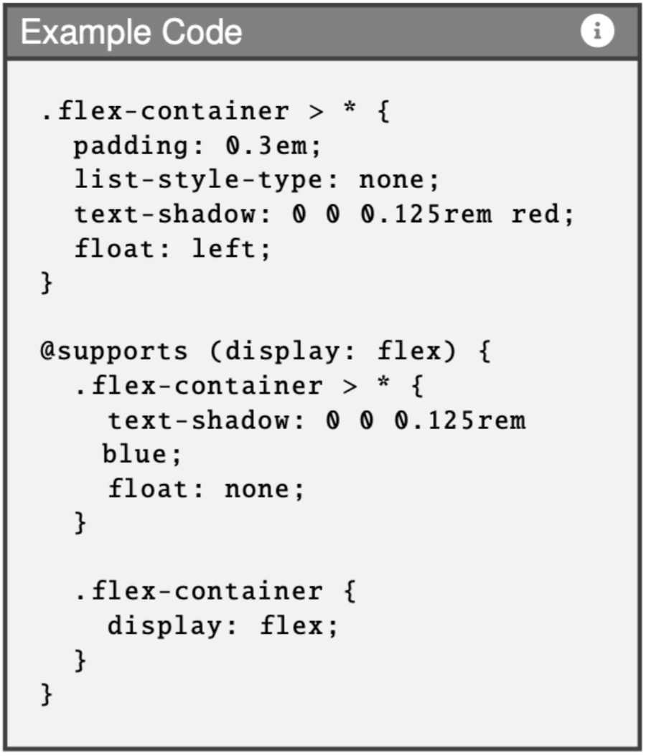
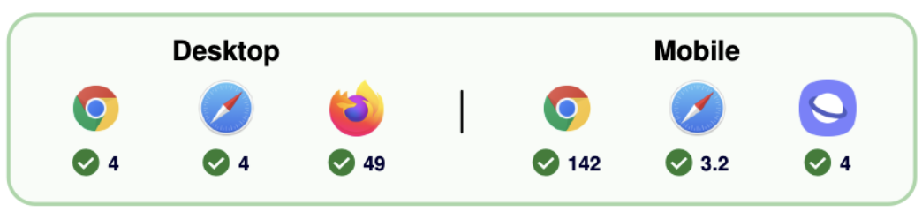
@-Rules: @supports
Baseline 2015
Test browser feature support.
Applies styles conditionally depending on support.
Enhances progressive enhancement.
1
2
1 https://caniuse.com/?search=%40supports
2 https://developer.mozilla.org/en-US/docs/Web/CSS/Reference/At-rules/@supports

Slide 13
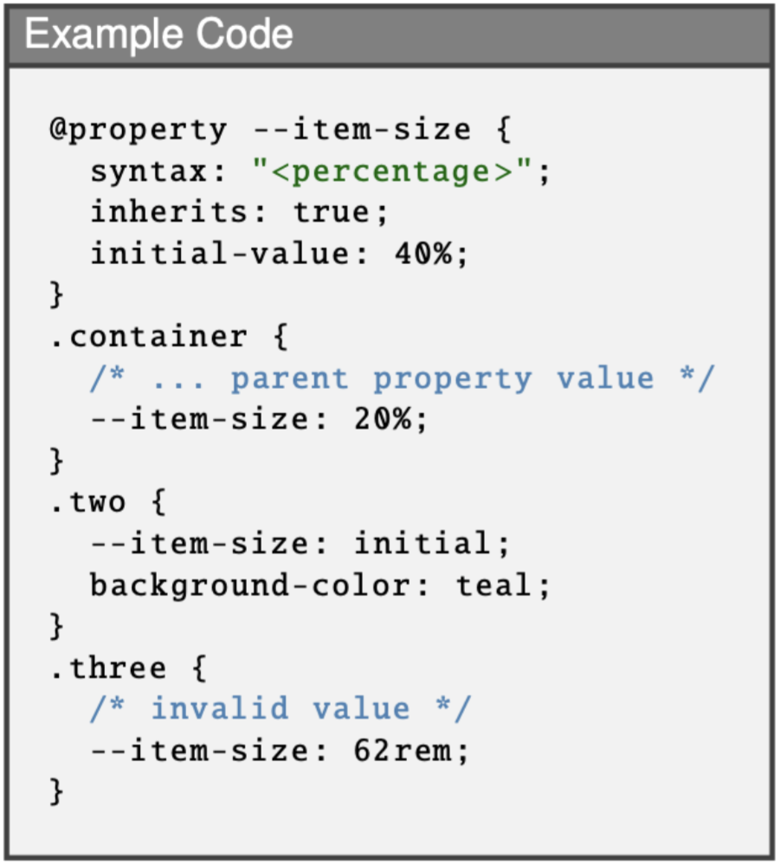
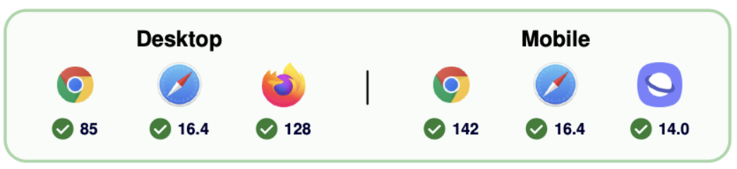
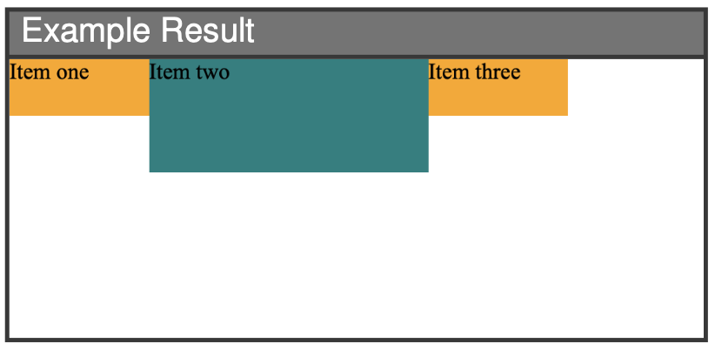
@-Rules: @property
Baseline 2024
Custom properties without JS.
Supports typed variables, default values, and inheritance.
1
2
1 https://caniuse.com/?search=%40property
2 https://developer.mozilla.org/en-US/docs/Web/CSS/Reference/At-rules/@property

Slide 14
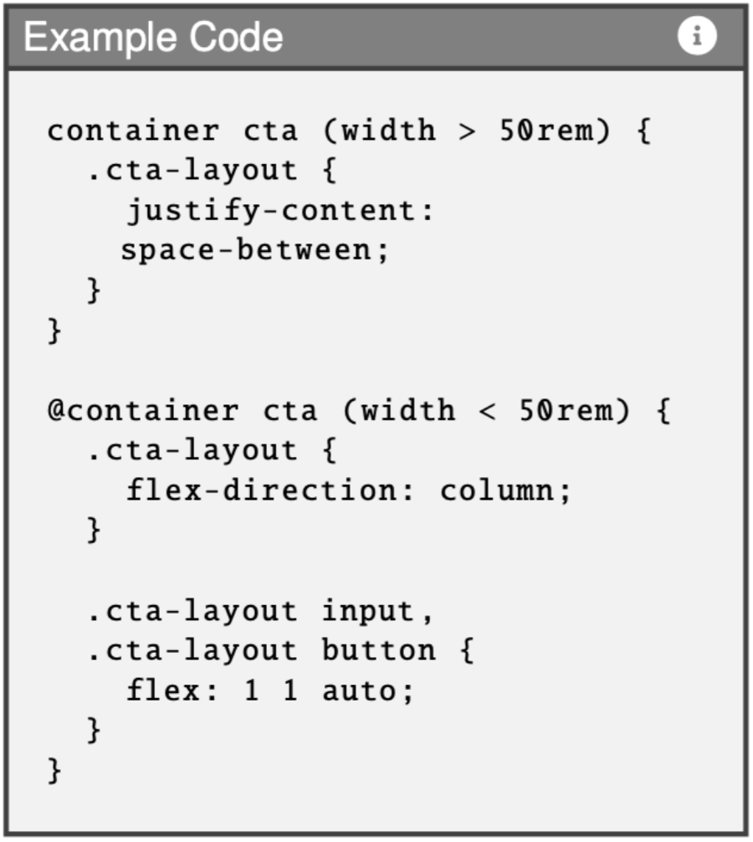
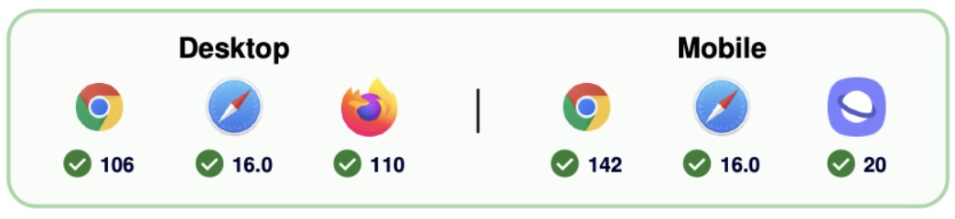
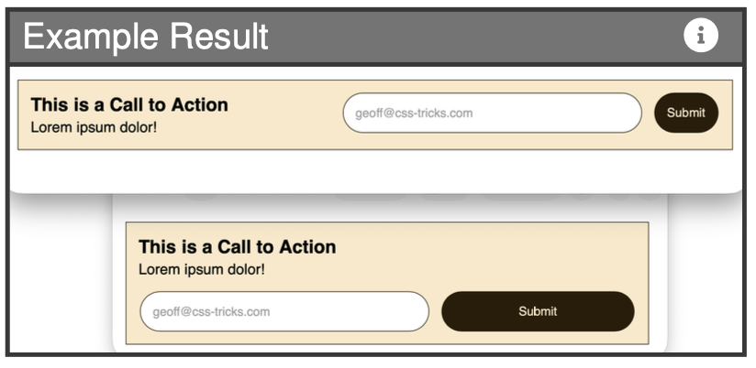
@-Rules: Container Size Queries
Baseline 2025
Size-based adjustment.
Apply styles based on the size of a container.
Conditional styles that activate when a container meets specific characteristics.
1
2
1 https://caniuse.com/?search=container+size+queries
2 https://css-tricks.com/css-container-queries/#container-queries-properties-amp-values

Slide 15
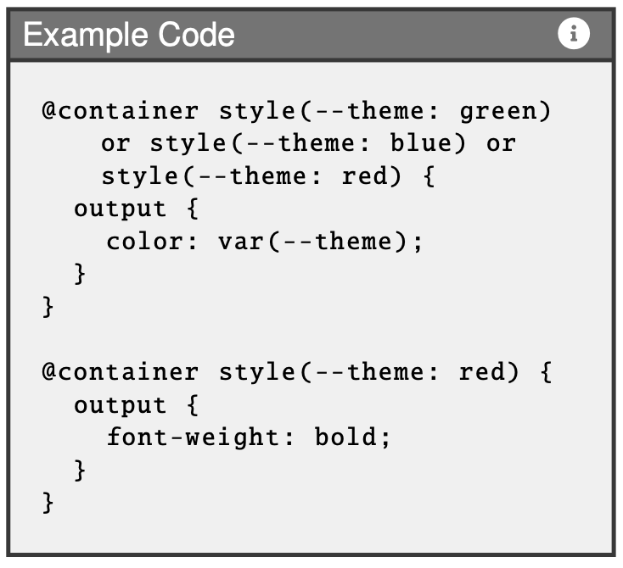
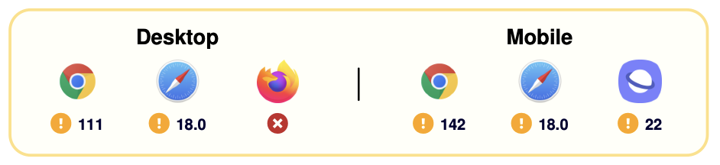
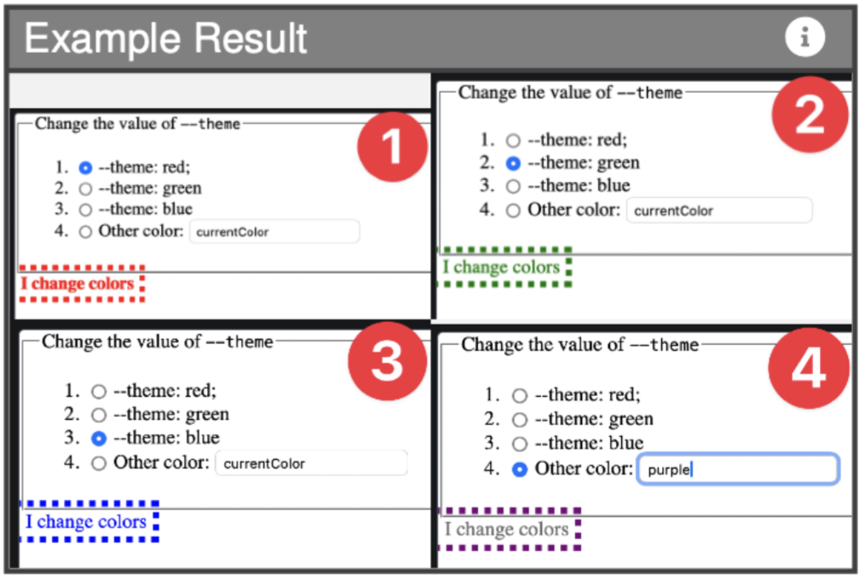
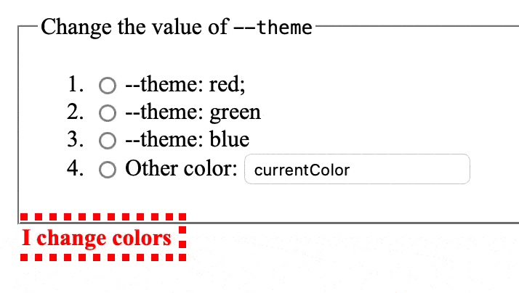
@-Rules: Container Style Queries
Experimental
Style-based adjustment.
Creates context-sensitive components.
Allows relations to characteristics like background-color.
1
2
1 https://caniuse.com/?search=container+style+queries
2 https://developer.mozilla.org/en-US/docs/Web/CSS/Guides/Containment/Container_size_and_style_queries

Slide 16
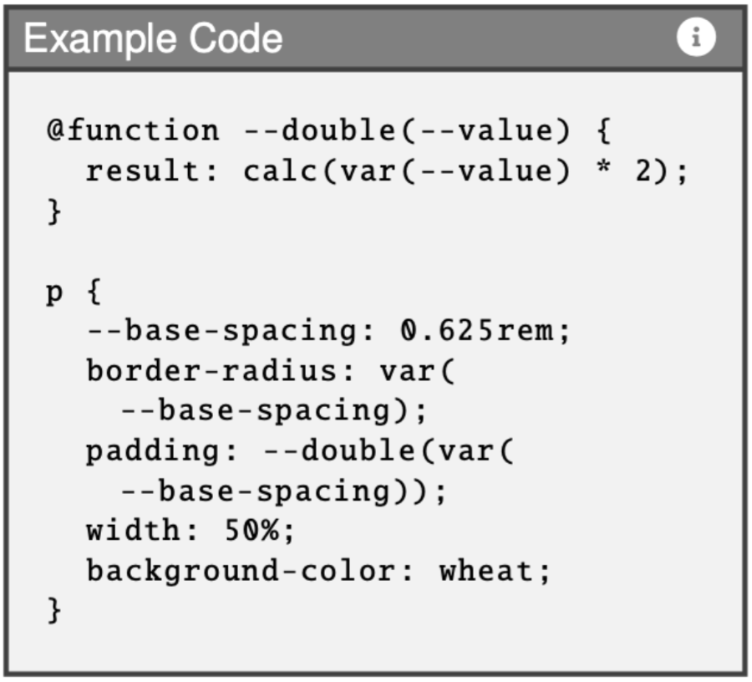
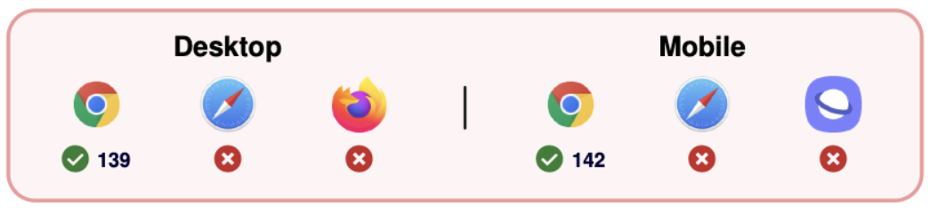
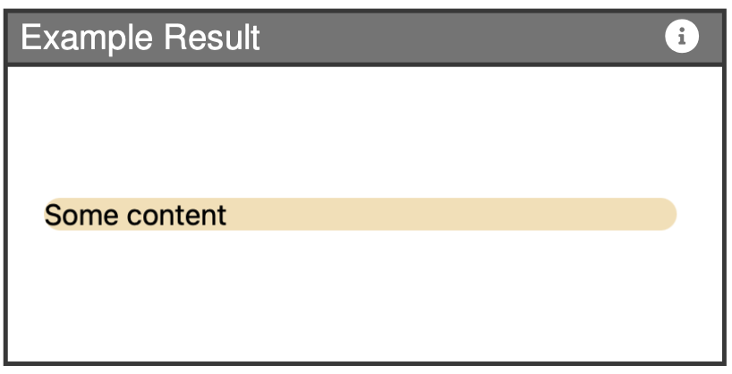
@-Rules: @function
Experimental
Define custom, reusable functions.
Perform calculations or logic.
Return single value.
Can be used in any CSS property.
1
2
1 https://caniuse.com/?search=%40function
2 https://developer.mozilla.org/en-US/docs/Web/CSS/Reference/At-rules/@function

Slide 17
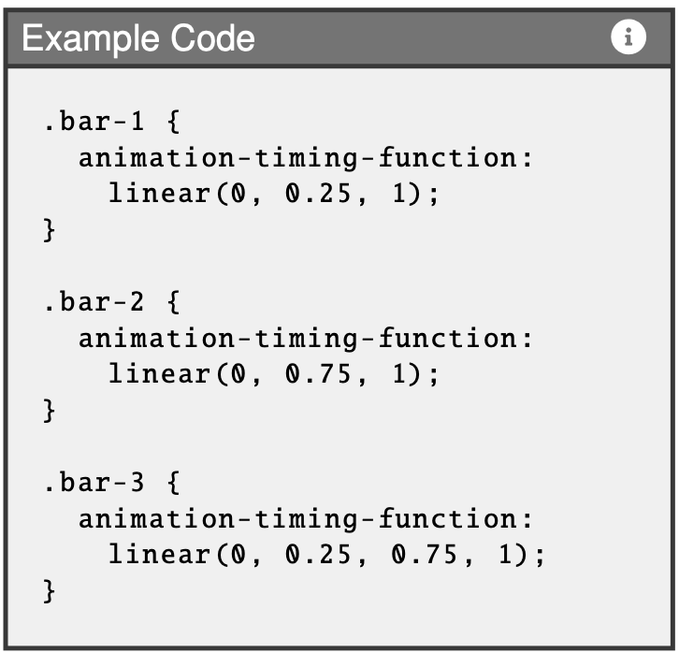

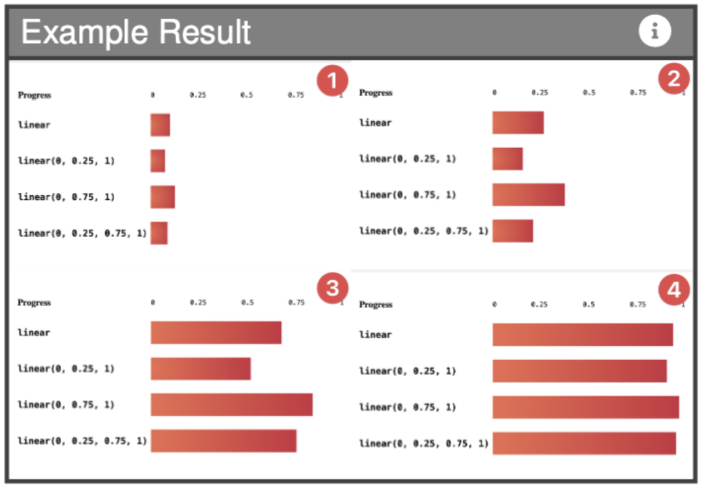
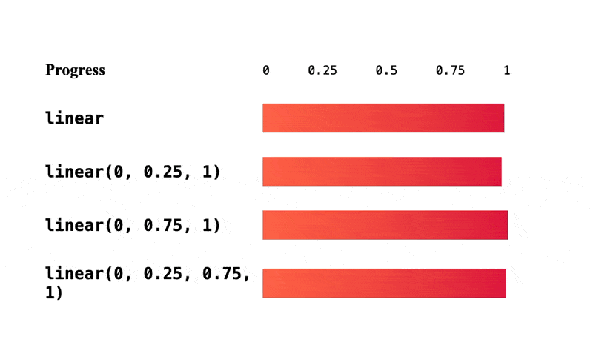
Functions: linear()
Baseline 2023
Used to control timing of CSS animations and transitions.
Creates a transition curve.
Allows definition of multiple intermediate points.
1
2
1 https://caniuse.com/?search=linear%28%29
2 https://css-tricks.com/almanac/functions/l/linear/

Slide 18
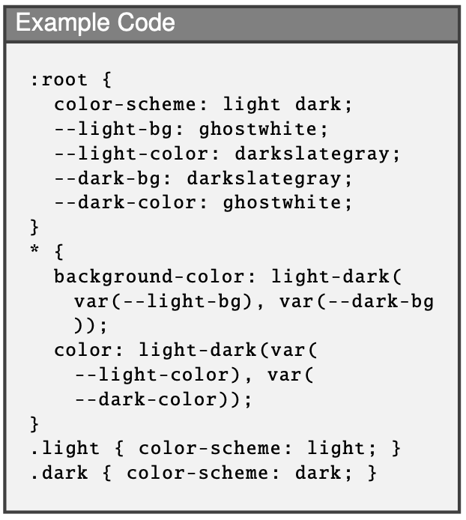
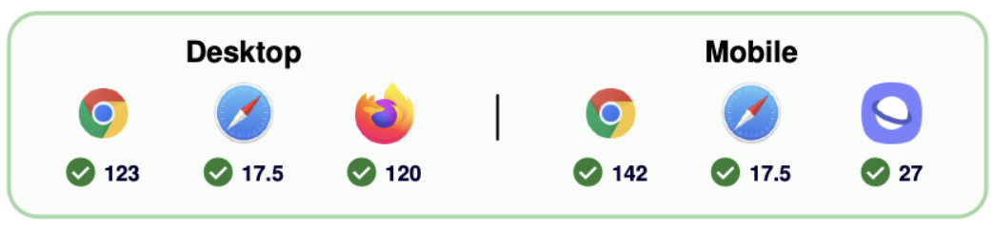
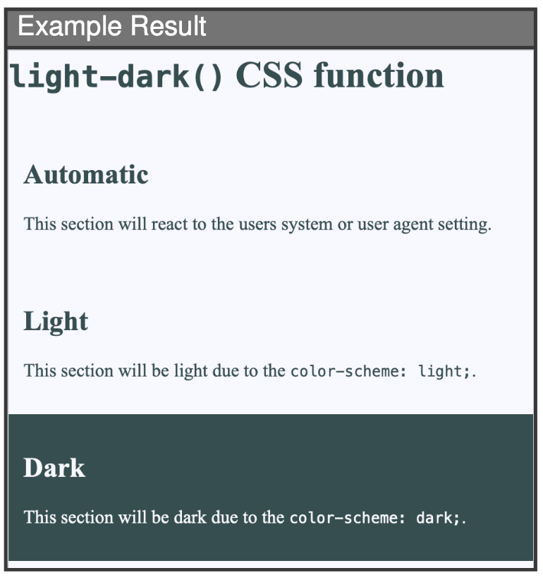
Functions: light-dark()
Baseline 2024
Change between light and dark modes.
Properties can be assigned 2 different colors.
Reduces effort for developers.
1
2
1 https://caniuse.com/?search=light-dark
2 https://developer.mozilla.org/en-US/docs/Web/CSS/Reference/Values/color_value/light-dark

Slide 19
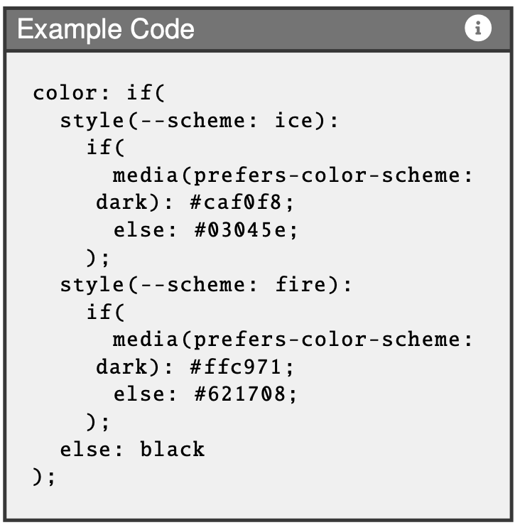
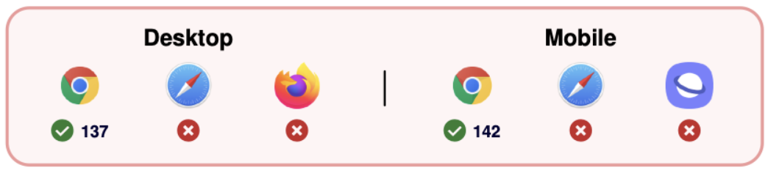
Functions: if()
Experimental
Mimics familiar if-else behaviour in CSS blocks.
Sets values based on conditional test.
Enables dynamic style logic.
Requires fallback options and allows nesting.
1
2
1 https://caniuse.com/?search=css+if%28%29
2 https://developer.mozilla.org/en-US/docs/Web/CSS/Reference/Values/if

Slide 20
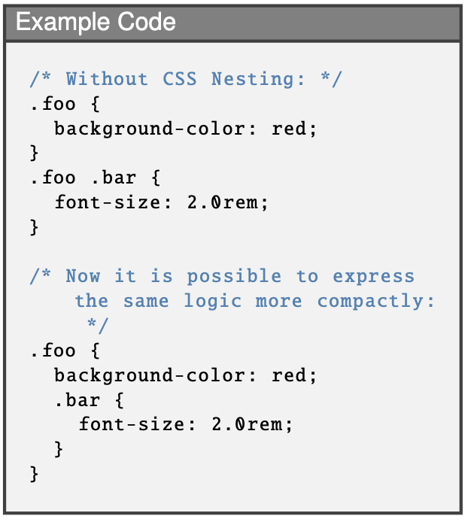

Other: CSS Nesting
Baseline 2023
Nesting of rules within on another.
Write code more compact and intuitive.
Increased readability, modularity, and maintainability of code.
1
1 https://caniuse.com/css-nesting

Slide 21
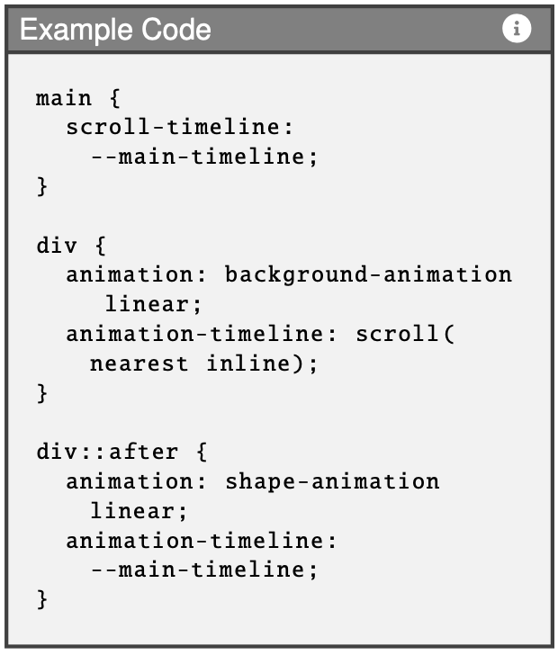
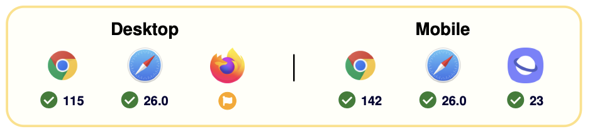
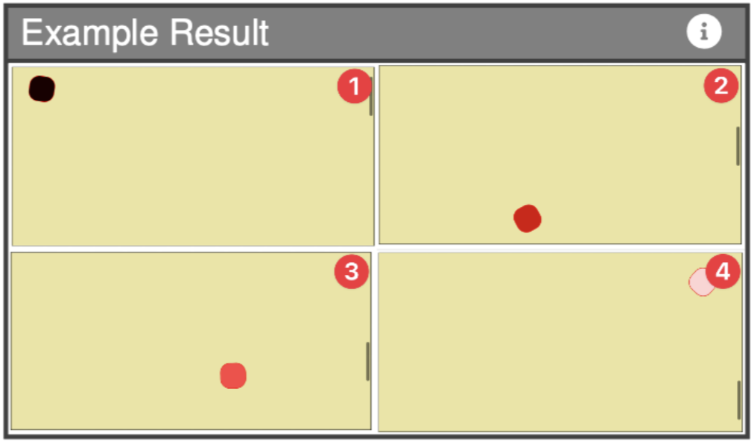
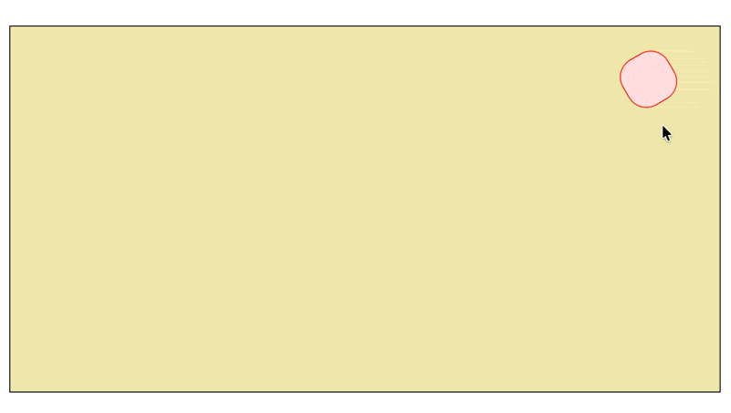
Other: Scroll-Driven Animations
Experimental
Traditionally implemented with JavaScript.
Animations linked directly to user’s scroll progress.
New possibilities to interactive web design.
1
2
1 https://caniuse.com/?search=scroll+driven+animations
2 https://developer.mozilla.org/en-US/docs/Web/CSS/Guides/Scroll-driven_animations

Slide 22
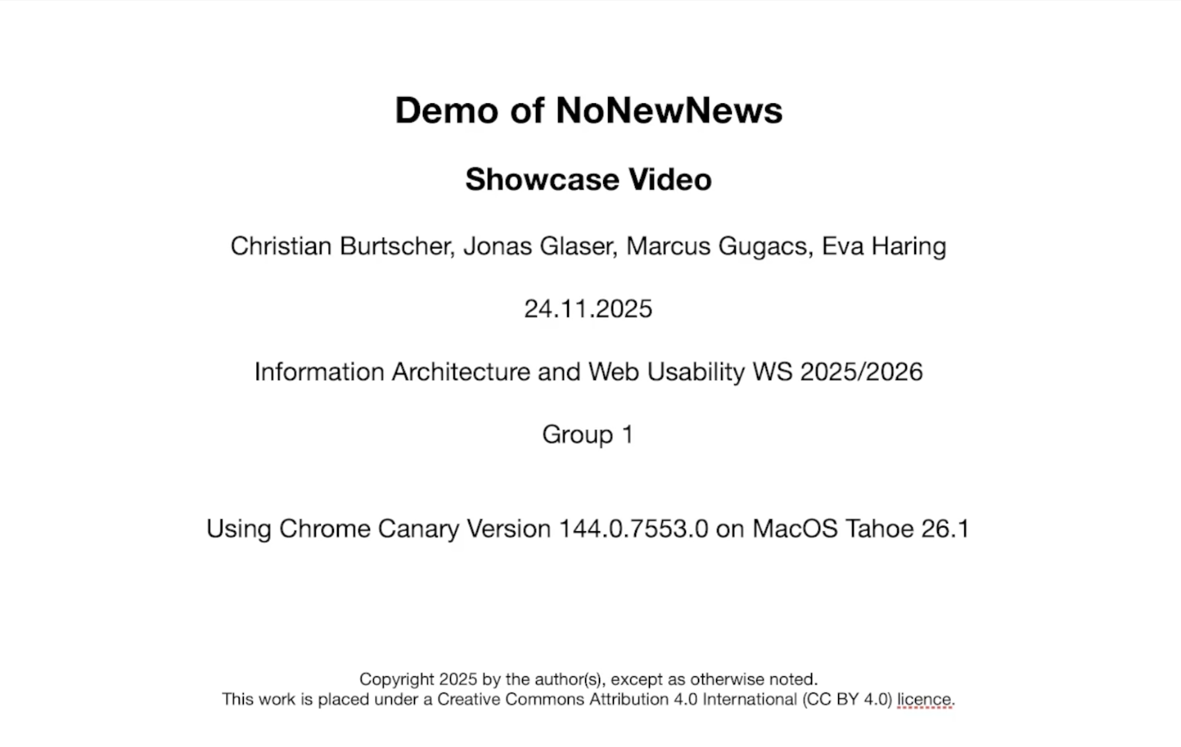
NoNewNews Demo
Youtube: https://youtu.be/-WVDrBNgazs
Github: https://github.com/gugacs/nonewnews
Live Preview: https://gugacs.github.io/nonewnews
/ 24

Slide 23
Future Work
Web ecosystem is frequently evolving.
Update & include further features.
Extend No New News by:
Implementing additional (sub-)routes.
Making it more accessible (extending aria-label usage).

Slide 24
Questions?

